Slide 1

3: Web Mining
152.152.98.11 - - [16/Nov/2005:16:32:50 -0500] "GET /jobs/ HTTP/1.1" 200 15140 "http://www.google.com/search?q=salary+for+data+mining&hl=en&lr=&start=10&sa=N" "Mozilla/4.0 (compatible; MSIE 6.0; Windows NT 5.1; SV1; .NET CLR 1.1.4322)“
252.113.176.247 - - [16/Feb/2006:00:06:00 -0500] "GET / HTTP/1.1" 200 12453 "http://www.yisou.com/search?p=data+mining&source=toolbar_yassist_button&pid=400740_1006" "Mozilla/4.0 (compatible; MSIE 6.0; Windows NT 5.1; SV1; MyIE2)"
252.113.176.247 - - [16/Feb/2006:00:06:00 -0500] "GET /kdr.css HTTP/1.1" 200 145 "http://www.kdnuggets.com/" "Mozilla/4.0 (compatible; MSIE 6.0; Windows NT 5.1; SV1; MyIE2)"
252.113.176.247 - - [16/Feb/2006:00:06:00 -0500] "GET /images/KDnuggets_logo.gif HTTP/1.1" 200 784 "http://www.kdnuggets.com/" "Mozilla/4.0 (compatible; MSIE 6.0; Windows NT 5.1; SV1; MyIE2)"
Hit Analysis
152.152.98.11 - - [16/Nov/2005:16:32:50 -0500] "GET /jobs/ HTTP/1.1" 200 15140 "http://www.google.com/search?q=salary+for+data+mining&hl=en&lr=&start=10&sa=N" "Mozilla/4.0 (compatible; MSIE 6.0; Windows NT 5.1; SV1; .NET CLR 1.1.4322)“
252.113.176.247 - - [16/Feb/2006:00:06:00 -0500] "GET / HTTP/1.1" 200 12453 "http://www.yisou.com/search?p=data+mining&source=toolbar_yassist_button&pid=400740_1006" "Mozilla/4.0 (compatible; MSIE 6.0; Windows NT 5.1; SV1; MyIE2)"
252.113.176.247 - - [16/Feb/2006:00:06:00 -0500] "GET /kdr.css HTTP/1.1" 200 145 "http://www.kdnuggets.com/" "Mozilla/4.0 (compatible; MSIE 6.0; Windows NT 5.1; SV1; MyIE2)"
252.113.176.247 - - [16/Feb/2006:00:06:00 -0500] "GET /images/KDnuggets_logo.gif HTTP/1.1" 200 784 "http://www.kdnuggets.com/" "Mozilla/4.0 (compatible; MSIE 6.0; Windows NT 5.1; SV1; MyIE2)"

Slide 2
Web Log Analysis
Hits analysis is the most basic level
of analysis
Behavior
Visits
Pages
HITS

Slide 3
Hit (Request) Analysis
Basic questions about visitors:
Who (were the visitors)
  IP, hosts, domains, regions
  User agents, Browser, OS, resolution
When (did they visit)
  By month, week, weekday, hour
What (did they they visit)
  Top pages, entry/exit, …

Slide 4
Who: IP to Hostname
IP address, e.g. 68.163.171.126
Can be converted to hostname, e.g.
  pool-68-163-171-126.bos.east.verizon.net
  Sometimes no hostname is found (unresolved)
Interactive Tools (Reverse DNS lookup)
  dnsstuff.com, network-tools.com
Program libraries
  Perl, …

Slide 5
Top-Level Domains (TLD)
Last part of the domain name is the TLD
Generic TLD
  .com (commercial) – mostly, but not necessarily US
  .net (ISP, network providers)
  .edu – US educational, e.g. conncoll.edu
  Other: .gov (government), .mil (military),
  .org (non-profit organization), .biz, .info …

Slide 6
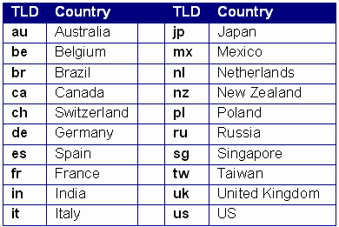
Top-Level Domains – country code ccTLD
2-letter Country TLD : >200 hundred countries
Some of the more common ccTLD
Full list at www.iana.org/cctld/cctld-whois.htm

Slide 7
Top-Level Domains – ccTLD issues
Some small countries resell their TLD, e.g.
    .cc (Cocos Islands)
    .tv
    .md
  www.analog.cc is not on Cocos Islands
  Trivia Question: Where in the world are Cocos Islands?

Slide 8
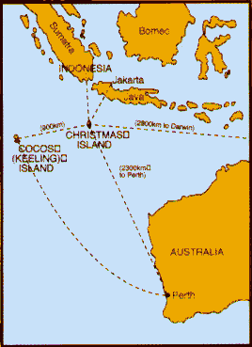
Top-level country codes: .cc
Cocos Islands are in the Indian Ocean, near Indonesia and Australia

Slide 9
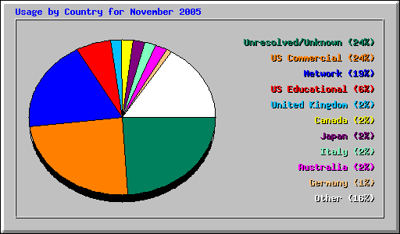
Example: KDnuggets Hits for Nov 2005 by Top-Level Domain
Observations: good for detecting anomalies and spikes
Not quite representative because bots were not excluded

Slide 10
Who: User Agent
Browser or bot send a “User Agent” string, which is recorded in web log
E.g.
"Mozilla/4.0 (compatible; MSIE 6.0; Windows NT 5.1; SV1; .NET CLR 1.1.4322)"
More details at
  http://en.wikipedia.org/wiki/User_agent

Slide 11
Bots
A Bot (software robot) is a program which accesses web pages
There are thousands of different bots in the “wild”.
Some are well-behaved, follow rules, and are easy to identify, e.g. Googlebot
Some violate the rules intentionally
Some are student projects … so any behavior is possible (:-)

Slide 12
Bot analysis can be useful
Some bot analysis can be useful, especially for SEO (Search Engine Optimization).
E.g. webmaster can determine how frequently Googlebot visits their pages and which pages are missed
ClickTracks tool includes search engine bot analysis
Topic for future lectures

Slide 13
User agent analysis: Bot or Not
“Good” bots use a clearly identifiable bot user agent
Common bot user agents
  Yahoo: "Mozilla/5.0 (compatible; Yahoo! Slurp; http://help.yahoo.com/help/us/ysearch/slurp)“
  Google: Mozilla/5.0 (compatible; Googlebot/2.1; +http://www.google.com/bot.html)“
  MSN: msnbot/1.0 (+http://search.msn.com/msnbot.htm)
  user agent includes “bot”, “crawler”, “libwww-perl”, or "Java/"
User agents that don’t begin with “Mozilla” or “Opera” are generally bots (with few exceptions)
Known bot list at www.psychedelix.com/agents/index.shtml

Slide 14
Bot or Not
Compile a list of most common user agents from web log
  Identify obvious bots
  Remove all hits from obvious bots
Analysis is never complete …

Slide 15
User Agent Browser Patterns:
Internet Explorer
Browser pattern can be dissected:
Internet Explorer
  Mozilla/MozVer (compatible; MSIE IEVer[; Provider]; Platform[; Extension]*) [Addition]
  Example:
    "Mozilla/4.0 (compatible; MSIE 6.0; Windows NT 5.1; SV1)
  IE version 6.0, Windows XP SP2

Slide 16
User Agent Browser Patterns
Firefox
  Mozilla/MozVer (Platform; Security; SubPlatform; Language; rv:Revision[; Extension]*) Gecko/GeckVer Firefox/ProdVer
  Example:
"Mozilla/5.0 (X11; U; Linux i686; en-US; rv:1.7.12) Gecko/20050920 Firefox/1.0.7"
Firefox 1.0.7 on Linux
More details: en.wikipedia.org/wiki/User_agent

Slide 17
User Agent Browser Patterns
Useful analysis
  Top browsers and their share
  Top OS

Slide 18
*Who: screen resolution
We can find out popular screen resolutions for human browsers
Create a 1x1 pixel image
Add special javascript code to a page which requests this image with parameters that specify screen width and height
Get web log requests to this image and analyze parameters
Useful for screen layout and web design

Slide 19
*Who: screen resolution, 1
Create or copy a 1x1 pixel image a.gif
  (Note: image name is not important)
Javascript code (simple version)
<SCRIPT LANGUAGE="JavaScript1.1" type="text/javascript">
<!–-
document.writeln('<img src="a.gif?' + 'width=' + screen.width + '&' + 'height=' + screen.height + '">');
// -->
</SCRIPT>
(Note: the wrappers around document.writeln are to hide this code from older browsers. More advanced version of Javascript checks the browser version)

Slide 20
*Who: screen resolution, 2
Analyze frequency of requests
GET /a.gif?width=nnn&height=hhh
Count most popular screen sizes (intermediate screen sizes should be rounded down, based on total # of pixels)
Less than 1024x768
1024x768
1280x1024
1600x1200
More than 1600x1200

Slide 21
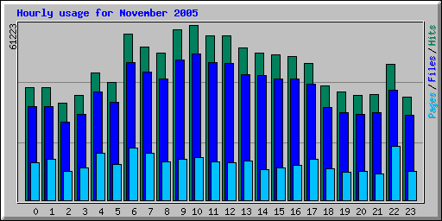
When: Usage By Time
By Hour
Observations:
1st Peak at 6 am – KDnuggets News emailed
2nd Peak at 9-10 am (work start on US East Coast, lunch on Pacific Coast
3rd Peak at 22:00 (10 pm)

Slide 22
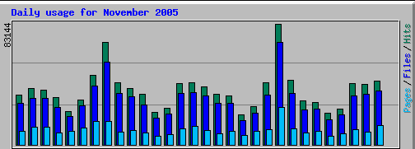
When: Usage By Day, …
By
Day
Weekday
Week
Month
…
TuWeThFrSaSu MoTuWeThFrSaSu MoTuWeThFrSaSuMoTuWeThFrSaSu MoTuWe
Observations:
Peaks on Nov 8, 22 –
KDnuggets News emailed
Work week periodicity (Sa/Su drop)

Slide 23
What: File types
Hits, Files, and Pages
File types
  HTML pages:
    Static: *.html, *.htm, */ (directory)
    Dynamic: *.php?*, *.pl?* …
  Image: *.gif, *.jpg, …
  Javascript: *.js
  PDF:
  …

Slide 24
What: Primary/Secondary
More important distinction is
Primary – requested directly by human browsers (usually)
  HTML pages
  Non-HTML (.pdf, .ppt, .txt …)
Components – requested as part of primary pages (usually)
  Image, CSS, Javascript , …
  Some HTML pages can be generated dynamically
Special pages
  robots.txt, favicon.ico, …

Slide 25
Usage analysis – entry/exit
Top entry and exit pages
Referrers
  Internal and external
Search engines
  Google, Yahoo, MSN, …
Search strings
  “data mining”
  “data mining software”

Slide 26
Web Usage Mining - Errors
404 Errors
  Top pages not found
  May indicate errors on site
  May also be requests for non-existing files
    /_vti_... : e.g. /_vti_bin/shtml.exe/_vti_rpc ,
    MS Front Page related requests
206 – Partially retrieved pages
  File too large
Notes:
Files related to MS Front Page Extensions is installed, and what
version it is.
_vti_ comes from Vermeer Technology, which was acquired by Microsoft and was a basis for MS Front Page

Slide 27
Web Usage Mining – Advanced
Behavior modeling
Goal: Improve Conversion
  Shopping card
  Ad clicks
  …
Unit of analysis is a visitor
  Combine related requests into a visit
  Combine visits into web behavior
  Combine web data with other data to build models

Slide 28
Summary
Web content mining
Web usage mining
  Web log structure
  Human / Bot / ? Distinction
  Request and Visit level analysis
Beware of exceptions and focus on main goals
Improve conversion by modeling behavior

